Slide 1
Estimating Geo-Location of Social Media Users based on Public Content
Presented by
Nitish Ranjan Bhowmik
&
Kazi Mazbah Uddin
Supervised by
Ms. Anna Fariha
Lecturer
Department of Computer Science and Engineering
University of Dhaka

Slide 2
Overview
Introduction
Related Works
Motivation
Objective
Contributions
Proposed Algorithm
Evaluation of Results
Comparison
Future Works
References
1

Slide 3
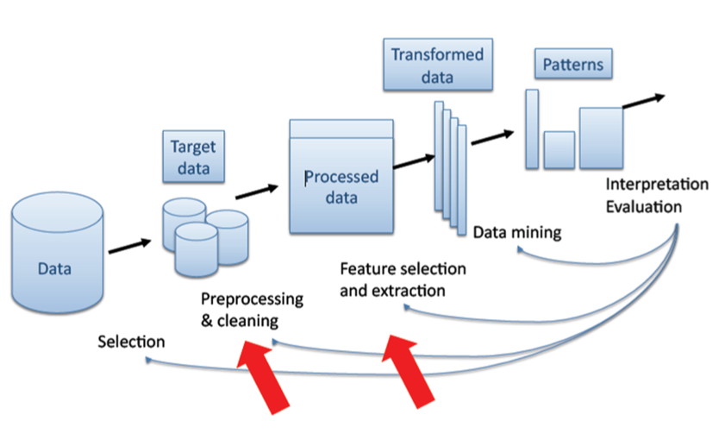
Introduction
Data Mining:
The process of emerging interesting knowledge and patterns from large amount of data.
2
Figure 1: Process of Data Mining

Slide 4
Text Mining
An intensive process of knowledge mining in which a user interacts with a document (contains of text or words).
Processing (Information retrieval/ Information Extraction)
Knowledge Discovery
Textual Data
Intermediate Data Collection
Visualization or Presentation
Figure 1: Text Mining Process Flow
3

Slide 5
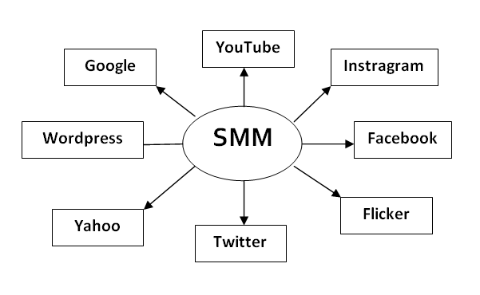
Social Media Mining
The process of representing, analyzing, and extracting interesting patterns from social media data.
4
Figure 2: Dimension of Social Media Mining

Slide 6
Related Works
Researchers proposed many approaches to estimate geo-location of microblogging site users.
Z. Cheng et al. [1]
Use Tweet for estimation of location
C. Chandra et al. [2]
Use Tweet and reply Tweets
5

Slide 7
Motivation(1/3)
With the rapid growth of social media over the last decade, individuals produce data at a revolutionary rate by sharing an interacting social media.
Finding location of these users is an interesting topic to research.
6

Slide 8

Motivation(2\3)
Detection of fake account
7

Slide 9

Motivation(3\3)
Better recommendation of advertisements
8
Figure 3: Advertisement suggestion on Twitter

Slide 10
Objective
To propose an approach that estimate geo-location of microblogging site users without using any external information, such as gazetteer, IP information.
Estimate location with higher accuracy than the state of art approach.
9

Slide 11
Contribution
We proposed a modified approach to estimate location with higher accuracy than the state of art approach, RPDM.
10

Slide 12

Overview of Working Procedure
Tweet Terms frequency
(PDM+RPDM)
Reply Tweet Terms Frequency
(alpha)
Estimation of Location of users
(FDM)
(1-alpha)
User Followers Location Info
11

Slide 13
Our Basic Idea for Improving Estimated Location
Estimate Location of User
Tweets and Reply Tweets of User
Location of Followers
of User
12

Slide 14
Data Set
Collecting publicly available tweets and reply tweets from Twitter.
Private tweet can’t be sampled because these tweets are only seen by the followers of that user.
We experimented on USA city level person tweet.
13

Slide 15
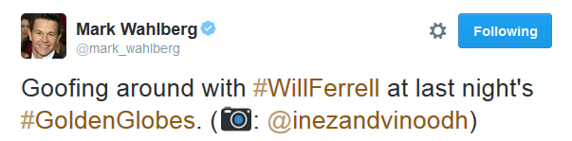
Data Set Collection
Twitter user name and tweets in the form of text line.
Fig 04:Example of @mark_whalberg Tweet
14

Slide 16
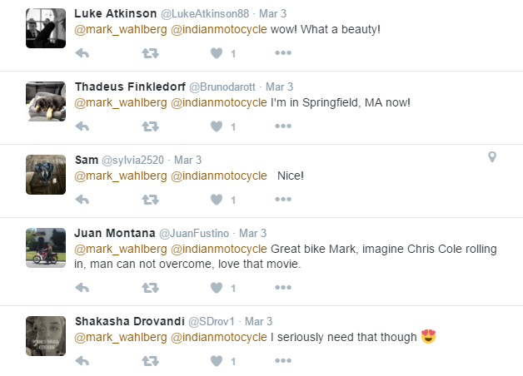
Data Set Collection
Reply tweets
15
Fig 05: Example of replies tweet of @mark_whalberg Tweet

Slide 17
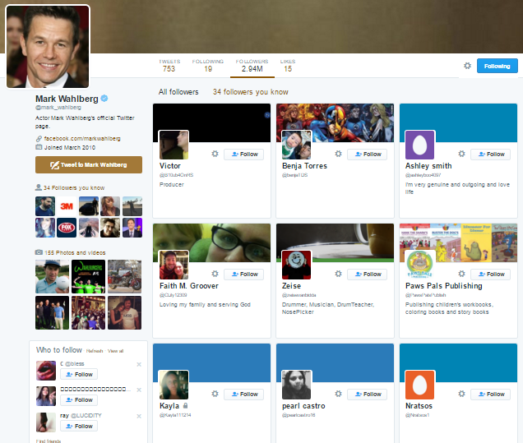
Data Set Collection
Tweet User Follower City Information.
16
Fig 06: Example of follower list of @mark_whalberg

Slide 18
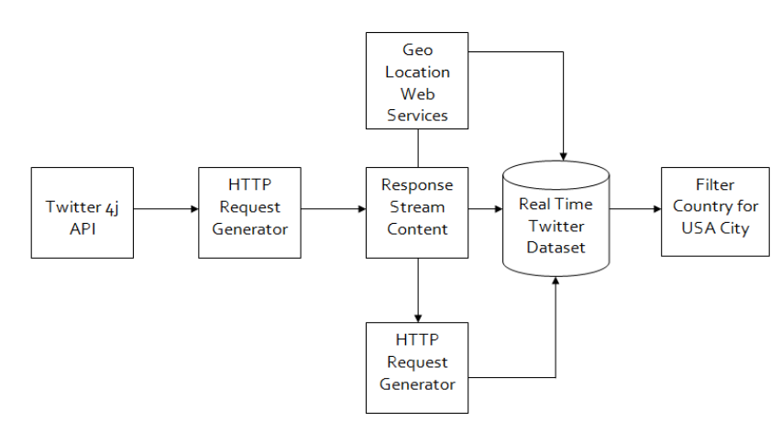
Data Collection
Twitter 4j 4.0.4 API
It is a Java library that can receive 30 requests of tweet per minute.
17
Fig 07: Twitter 4j API Framework

Slide 19
Data Set Collection
Prefixing Word Hashtags(#) removed
Removing Spam Tweets
Removing unnecessary links of website, blogs etc., from our data sets.
18

Slide 20
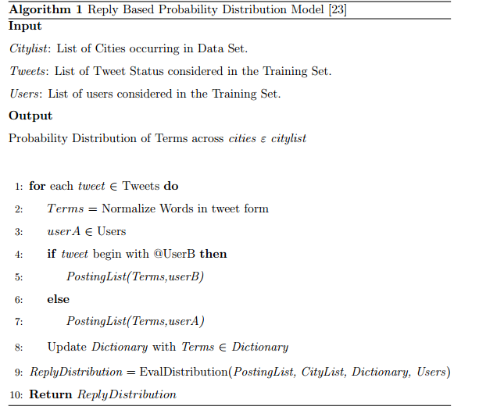
Pseducode for Calculating Probability Distribution using RPDM
19

Slide 21
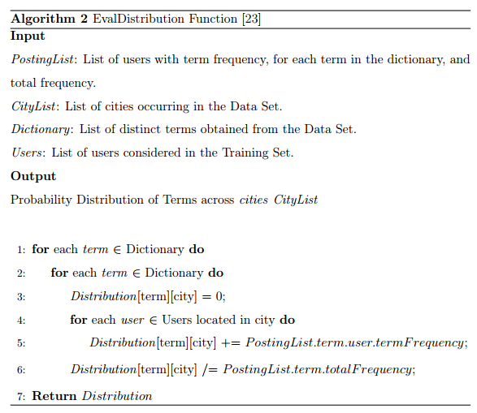
Pseducode for Calculating Probability Distribution using RPDM
20

Slide 22
Probability Distribution Matrix
 | city-1 | city-2 | city-3 | …… cityn
Term-1 | P(c1|t1) | P(c2|t1) | P(c3|t1) | ……. P(cn|t1)
Term-2 | P(c1|t1) | P(c2|t2) | P(c2|t2) | ……. P(cn|t2)
Term-3 | P(c1|t1) | P(c2|t3) | P(c2|t3) | ……. P(cn|t2)
Term-4 | P(c1|t1) | P(c2|t4) | P(c2|t4) | ……. P(cn|t2)
. | . | . | . | .
. | . | . | . | .
. | . | . | . | .
. | . | . | . | .
Term-n
P(city|term) = (term occurs in city c) / |t|;
where,|t| = total term count in whole dataset
21

Slide 23
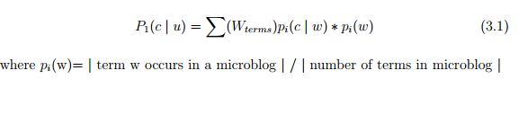

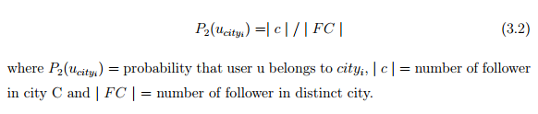
Experiment
22

Slide 24
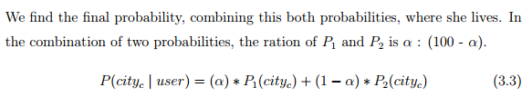
Equation 3
23

Slide 25
Frequencies of Terms of Tweet
Calculating the total status of each word frequencies table from all of the cities which is taken from tweet with the help of global dataset frequencies.
Term | Frequencies
Goofing | 53
with | 76
WillFerrell | 12
last | 94
Night’s | 107
around | 117
GoldenGlobes | 263
24

Slide 26
Frequencies of Terms along with Cities
Calculating the status word frequency table across the cities which is taken from tweet with the help of global dataset frequencies.
 | Seatle | Brooklyn | LA | LakeWood | LasVegas | Miami
Goofing | 12 | 19 | 11 | 5 | 4 | 2
with | 11 | 12 | 13 | 14 | 15 | 12
WillFerrell | 1 | 6 | 1 | 2 | 1 | 1
last | 10 | 14 | 12 | 18 | 21 | 19
Night’s | 13 | 16 | 11 | 19 | 23 | 25
around | 23 | 15 | 14 | 22 | 24 | 19
GoldenGlobes | 45 | 14 | 71 | 21 | 49 | 63
24

Slide 27
Calculating Frequencies of Terms of Reply Tweets
Term | Frequencies
amazing | 61
playing | 117
dusty | 43
daddy's | 85
home | 74
Dad | 93
Step | 95
Term | Frequencies
movie | 69
Daddy's | 85
Home | 74
looks | 94
really | 107
like | 54
Term | Frequencies
really | 107
nice | 45
picture | 142
always | 71
black | 25
white | 59
best | 16
@elliejayneg
@LisaKateland13
@Lorrain8662774
25

Slide 28
Frequencies of Reply Comment Terms alongside with Cities
 | Seatle | Brooklyn | LA | LakeWood | LasVegas | Miami
amazing | 12 | 31 | 21 | 26 | 10 | 30
playing | 16 | 19 | 23 | 26 | 18 | 15
dusty | 5 | 9 | 11 | 10 | 5 | 3
daddy's | 15 | 6 | 18 | 21 | 12 | 13
Dad | 18 | 15 | 26 | 13 | 11 | 10
picture | 27 | 33 | 21 | 19 | 27 | 15
...... | ... | ... | ... | ... | ... | ...

Slide 29
Calculation of probability of a user’s location using tweet and reply tweet:
P(Seatle|Goofing) = 12/53 = 0.226415
. . . . .
P(Seatle|GoldenGlobes) = 45/263 = 0.171102
P(Brooklyn|Goofing) = 19/53 = 0.358490
. . . . .
P(Brooklyn|GoldenGlobes) = 14/263 = 0.05323
P(LA|Goofing) = 11/53 = 0.207547
. . . . .
P(LA|GoldenGlobes) = 71/263 = 0.2699619
..........
..........
..........
P(Miami|Picture) = 15/142 = 0.105633
26

Slide 30
Continue…
Where p(term) = | term t occurs in tweet| / | total no. of terms in that tweet |
We will also calculate this for reply tweets using this same approach.
27

Slide 31
P[w]
Probability of
p(W) = | W | / | terms|
Where |t| = term
total no. of terms in that tweet = 7
Term | Terms in tweet
Goofing | 1
with | 1
WillFerrell | 1
last | 1
Night’s | 1
around | 1
GoldenGlobes | 1
Term | Terms in tweet
Goofing | 1/7 = 0.14285
with | 1/7 = 0.14285
WillFerrell | 1/7 = 0.14285
last | 1/7 = 0.14285
Night’s | 1/7 = 0.14285
around | 1/7 = 0.14285
GoldenGlobes | 1/7 = 0.14285
p(term)
28

Slide 32
P(city-a|user)
P(Seatle|@mark_wahlberg) = {P(Seatle|Goofing) *p[Goofing] + P(Seatle|with) * *p[with] + P(Seatle|WillFerrell) * p[WillFerrell] +. . . + P(Seatle| picture) * p[picture]} = 0.5175
.
.
.
P(Miami| |@mark_wahlberg) =
{P(Miami|Goofing) *p[Goofing] + P(Miami|with) * *p[with] + P(Miami|WillFerrell) * p[WillFerrell] +. . . + P(Miami| picture) * p[picture]} = 0.2345
29

Slide 33
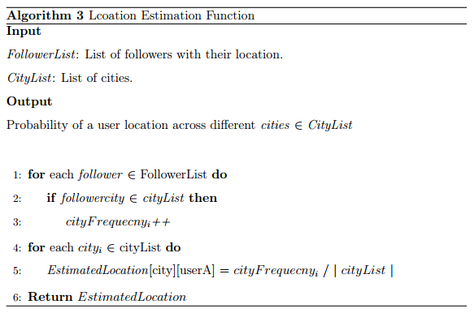
Pseudocode for evaluating the Location Estimation given in Algorithm 3
30

Slide 34
Calculation of probability of a user’s location using his follower’s information:
Probability of a user belongs to city, c
P(u_city_i) = | c | \ | FC |
Where, | FC | = number of followers
31

Slide 35
Users Followers Location Information
Follower Name | Location/City
@Jason | NewYork
@Mathews | LasVegas
@Jhon | LA
@Robert | Ohio
@Thomas | NewYork
@Richard | LasVegas
@Edward | Brooklyn
@Dominic | LA
. . . | . . .
. . . | . . .
32

Slide 36
Frequency of Cities
Location/City | Frequency of city
Seatle | 5
Ohio | 4
LA | 16
LakeWood | 11
LasVegas | 6
Miami | 12
NewYork | 5
. | .
. | .
. | .
33

Slide 37
Calculation of P(u_city_i)
Numnber of Total Follower = 60
P(Seatle|@mark_wahlberg) = 5/60 = 0.083333
P(LA|@mark_wahlberg) = 16/60 = 0.26667
P(LakeWood|@mark_wahlberg) = 11/60 = 0.18333
.
.
.
P(Texas|@mark_wahlberg) = 3/60 = 0.05
34

Slide 38
Calculation of Combined Probability of a User's Location
Taking alpha weight from P1(PDM + RPDM) and (1 - alpha) weight from P2(Followerlocation List) in the combination, we calculate the final probability.
35

Slide 39
Calculation of combined probability of a user’s location:
P(city c | user) = (alpha)* P1(city c) + (1-alpha)* P2(city c)
We took alpha weight from P1(PDM+RPDM) and (1-alpha) weight from p2(Follower location List) in the combination.
Alpha = 20%, 30%, 50%, 70%
36

Slide 40
Calculation of Combined Probability of a User's Location
Location | Probability
Miami | 0.5175
Seatle | 0.4384
LA | 0.4123
Brooklyn | 0.3987
LakeWood | 0.3245
LasVegas | 0.2765
Miami | 0.2345
. | .
. | .
. | .
37

Slide 41
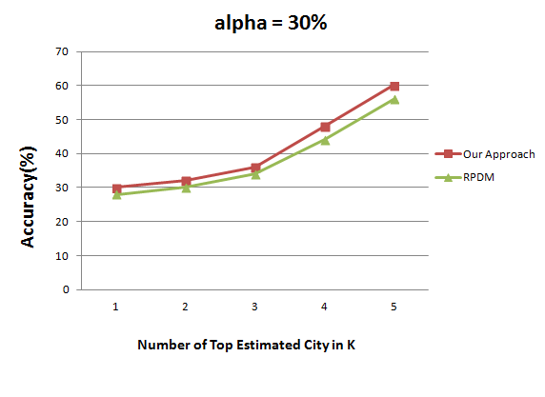
Experimental Result(1/5)
38

Slide 42
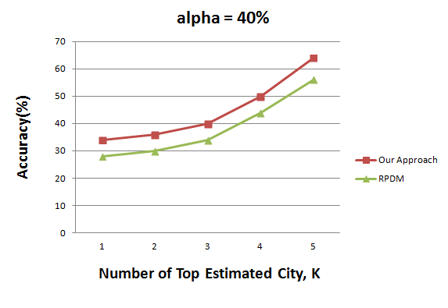
Experimental Result(2/5)
39

Slide 43
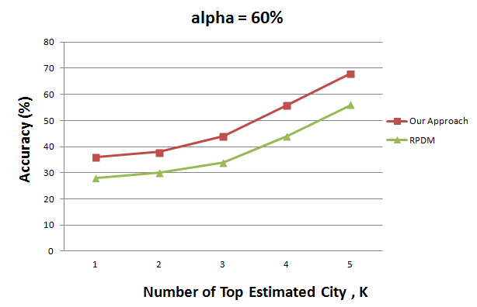
Experimental Result(3/5)
40

Slide 44
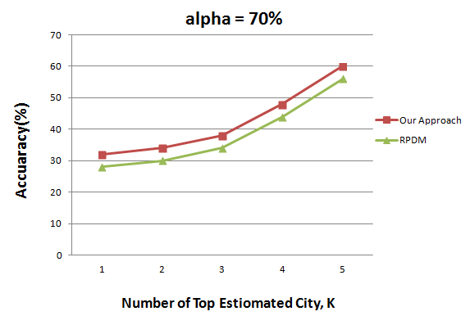
Experimental Result(4/5)
41

Slide 45
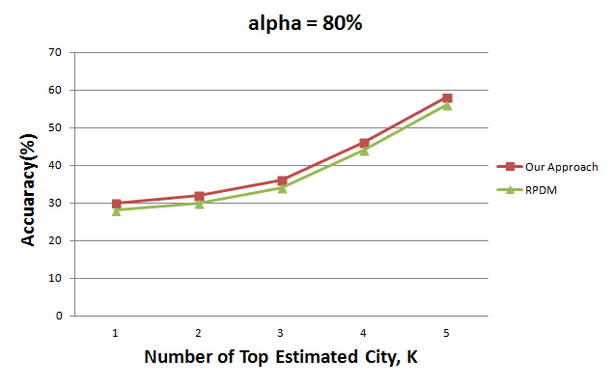
Experimental Result(5/5)
42

Slide 46
Scopes of Future Work
Removing common terms such as ‘how’, ‘is’, ‘are’ etc. which will reduce processing time and database size.
Find a user’s nearby followers. It will help to estimate her location more accurately.
Propose a model to handle multiple languages.
43

Slide 47
Reference
[1] Z. Cheng, J. Caverlee, K. Lee, and D. Z. Sui, \You are tweet where you are," ICWSM, vol. 2011, pp. 81{8}
[2] S. Chandra, L. Khan and F.B Muhaya, “Estimating twiiter user location using social intereactions-a-content based approach,” IEEE third international conference
44

